Slide 1

Oracle Apex Using Oracle Autonomous DB
Team 7
BY
Rajasekhar Reddy Kolagotla
Chanakya Rudhra Baluguri
Sandeep Reddy Yeruva

Slide 2
What is Oracle Autonomous DB?
Oracle Autonomous Database is a cloud-based service that provides a fully automated, self-managing database environment. It uses machine learning and artificial intelligence to automate all aspects of database management, including provisioning, patching, scaling, and security. This frees up database administrators (DBAs) to focus on more strategic tasks, such as data modeling and application development.
Oracle Autonomous DB is based on the worlds best database platform Exadata.
Autonomous DB eliminates the complexity of operating and securing Oracle DB, while giving the customers highest levels of performance, scalability, and availability.
Notes:
For starters Oracle Autonomous Database is a cloud database service offered by Oracle Corporation, which is notable for its use of artificial intelligence and machine learning to automate various database management tasks.

Slide 3
Available in both public and on-premises cloud
Autonomous DB uses proven technologies like RAC, Data Guard, DB Vault, Parallel SQL, In-memory, multitenant, etc.
Oracle autonomous Db is more reliable because it automatically recovers from any physical failures, whether at the physical server or data center level.
Serverless and elastic architecture enables instant scaling online.
Pay only for the resources used.
All scaling operations occur while the applications continue to run.
Cost reduced by 90%, by automating every aspect of the stack from infrastructure, to the DB, to ML Based Automation.

Slide 4
Key Features
Provision
Secure
Manage
Protect
Scale
Optimizes

Slide 5
Oracle Apex
Oracle Application Express (APEX) is a low-code application development platform that enables developers to build scalable, secure web and mobile applications quickly and easily.
It is a free and fully supported feature of Oracle Database, so organizations can start developing applications immediately without having to purchase any additional software.
Oracle APEX is a popular choice for developers because it is easy to use and does not require a lot of coding experience.

Slide 6
Oracle APEX Key features:
Low-code development
Scalability
Security
Data Visualization and Analysis
Integration

Slide 7
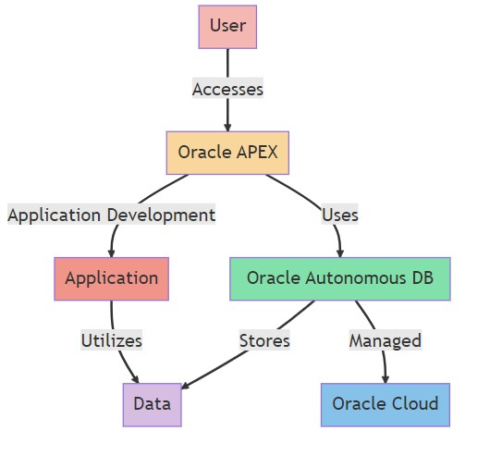
Architecture
End-users’ interaction with Oracle APEX, the user interacts with an application that is built using oracle APEX.
When building or running applications, APEX uses Oracle Autonomous Database to store and retrieve data.
Notes:
User is a entity that interact with the system.
User gains entry to system via OrAPEX, which is a web-based softdev eniv that runs on OracDB.
AppDev OrcApex is used for appdev. This involves creating applications

Slide 8
Application represents the software or system being developed or operated; this application uses data from Oracle Autonomous DB to perform the functions.
Data represents the raw information or records that the application and the database handle.
Oracle Cloud provides servers, storages, and other functionalities that allows businesses to run their applications in the cloud
Notes:
1.Or Auto DB: Application developed with oraAPEX utilizes the OrAutDB which is a cloud based database service that uses ML to automate tuning, security, Backup,Updates.
2.Data: applications uses data to process and manipulate various functionalities.
3.OracleDB is responsible for storing data that the app used. With high security.
4.Oracle Cloud: Oracle AutonDB is managed by Oracle cloud which provides support and services

Slide 9
Dataset Used:
we are using a real-world e-commerce dataset from Olist, the largest department chain store in Brazilian marketplace.
We Performed data cleaning on the existing dataset to remove unwanted data.
Using Oracle Apex, we aim to demonstrate the effectiveness of this integration in handling complex database operations and providing insightful data visualization.
Notes:
From Kaggle Regional Lang and used py script to tranWe have Multiple tables and used the only the required tables

Slide 10
E-commerce Websites Analysis
In this project, we made use of Oracle Apex for frontend and Oracle Autonomous DB for the backend database management.
We also performed the CRUD operations on the dataset and analyzed the data.
We showcased the results through various visualization techniques using Oracle Apex.

Slide 11
Database Schema
Customers (Customer ID, Full Name, Email Address)
Stores (Store ID, Store Name, Physical Address, Store Contact Number, Store Email, Web Address)
Products (Product ID, Product Name, Category, Unit Price, Product Description)
Orders (Order ID, Order Date, Customer ID, Order Status, Store ID)
Order Items (Order ID, Product ID, Quantity)
Order Payments (Payment ID, Order ID, Payment Type)
Order Reviews (Review ID, Order ID, Rating, Review Message)

Slide 12
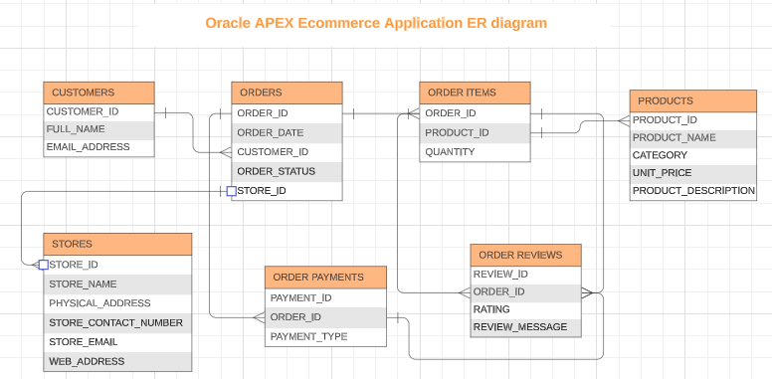

Slide 13
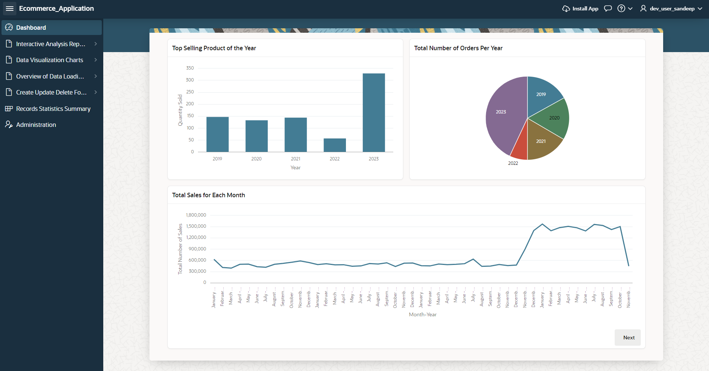
Dashboard:
Notes:
The version we used is a free tire 19c with limited storage of 4GB the billing cycle will start based on the uasage.

Slide 14
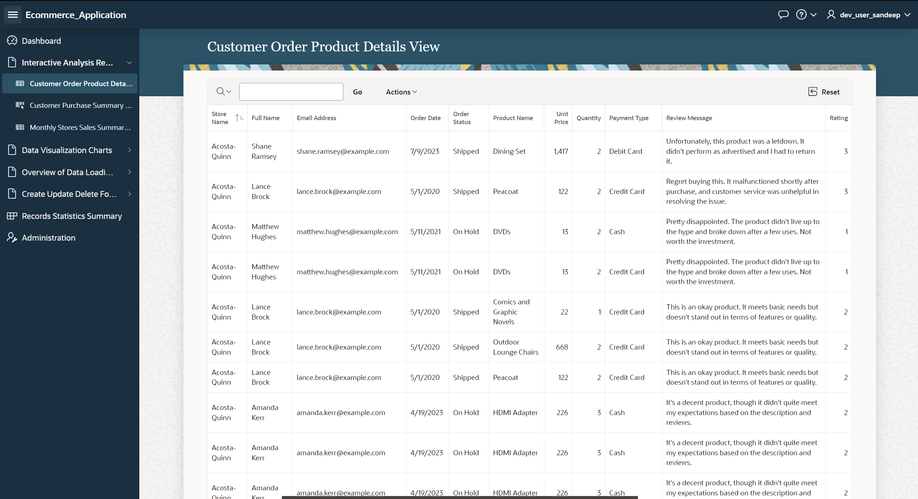
Customer Order Product Details View: This report displays the customer details, order details, and the product details. We can customize this report by using aggregate functions.

Slide 15
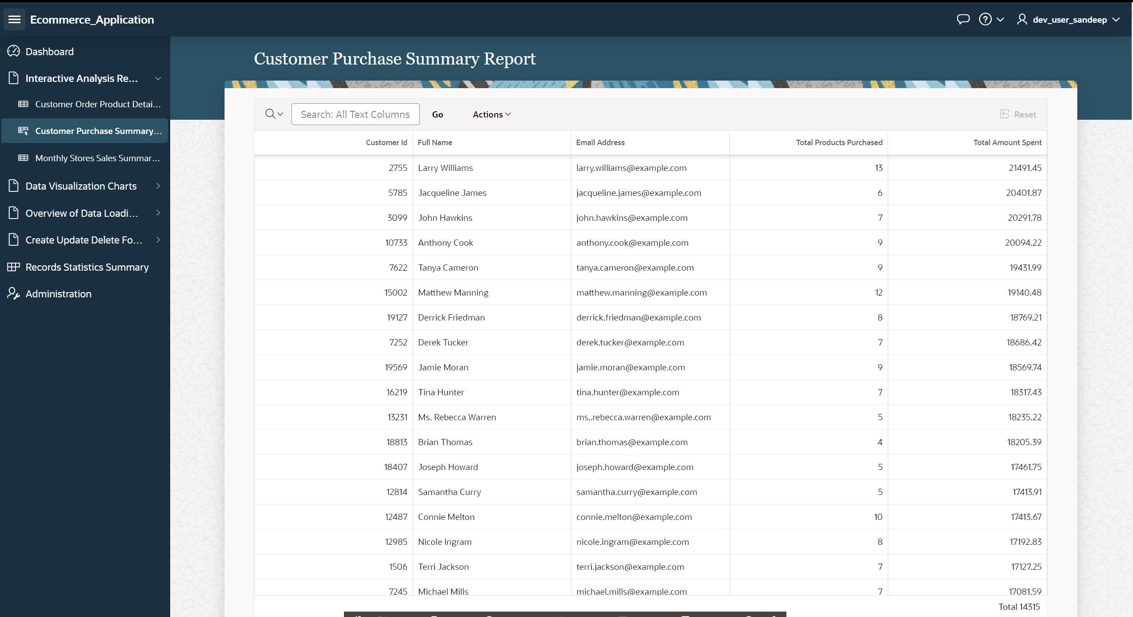
Customer Purchase Summary Report: This report displays the details of each customer and the total amount spent over the years.

Slide 16
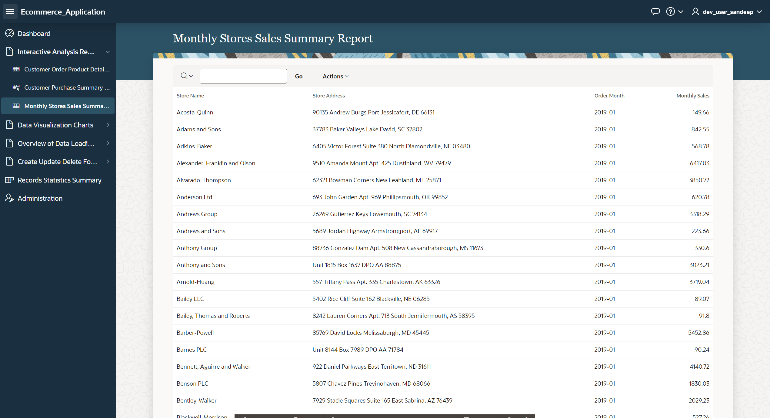
Monthly Stores Sales Summary Report: This report displays the monthly sales of each store.

Slide 17
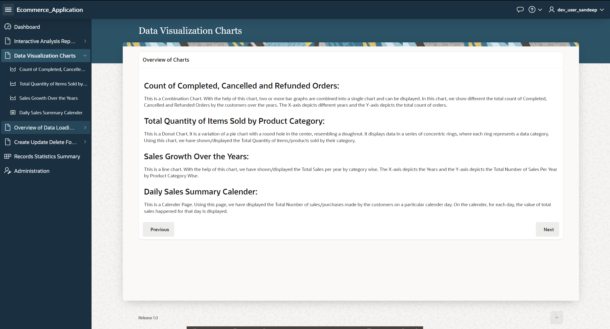
Data Visualization Charts

Slide 18
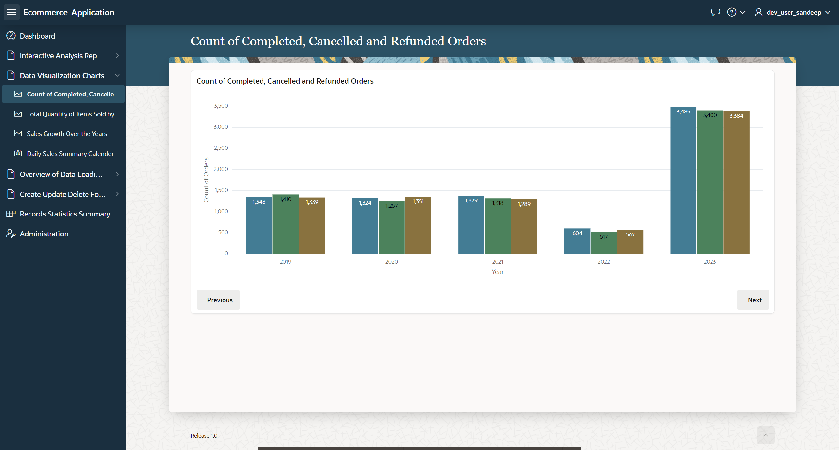
This is a combination chart which displays the total count of Completed, Cancelled and Refunded Orders over the years.

Slide 19
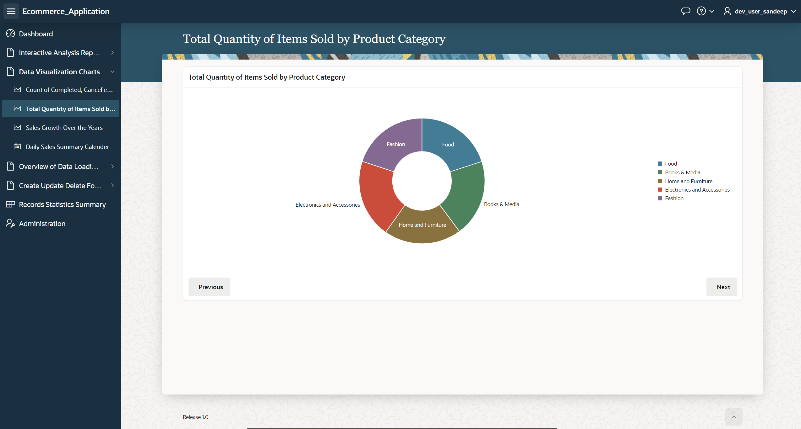
Total Quantity of Items Sold by Product Category: It displays the total quantity of items sold according to product category

Slide 20
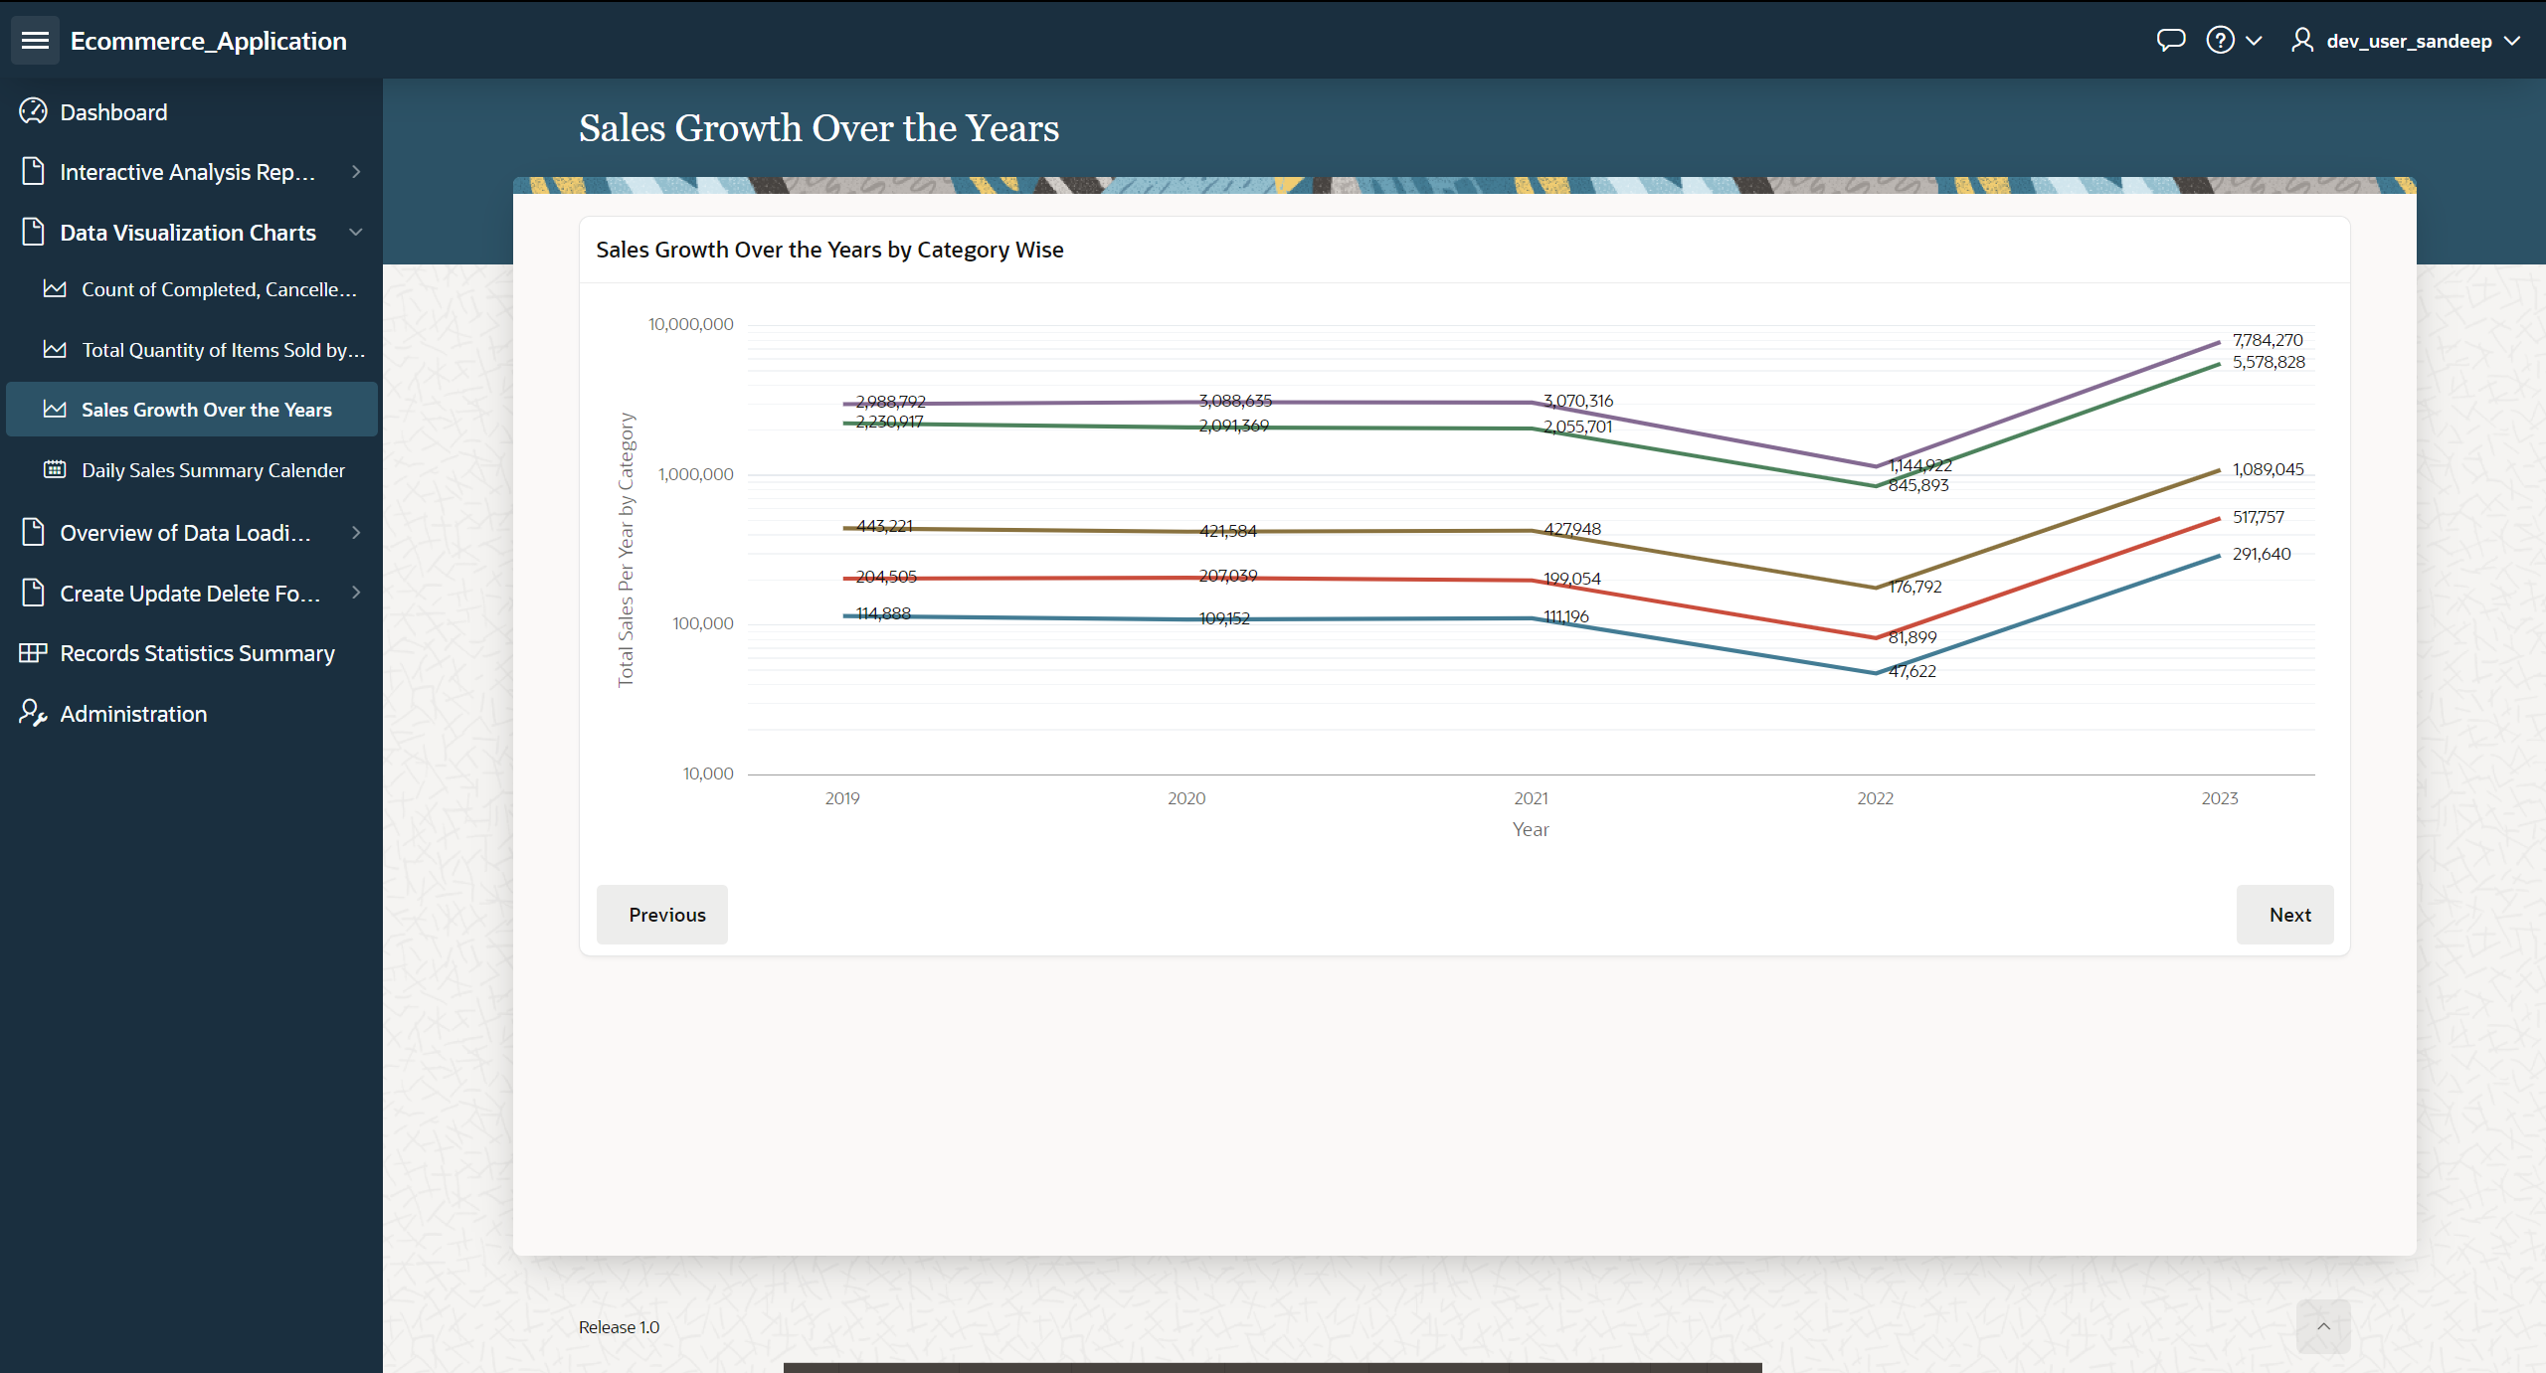
Sales Growth Over the Years: It displays the every year sales growth by category wise.

Slide 21
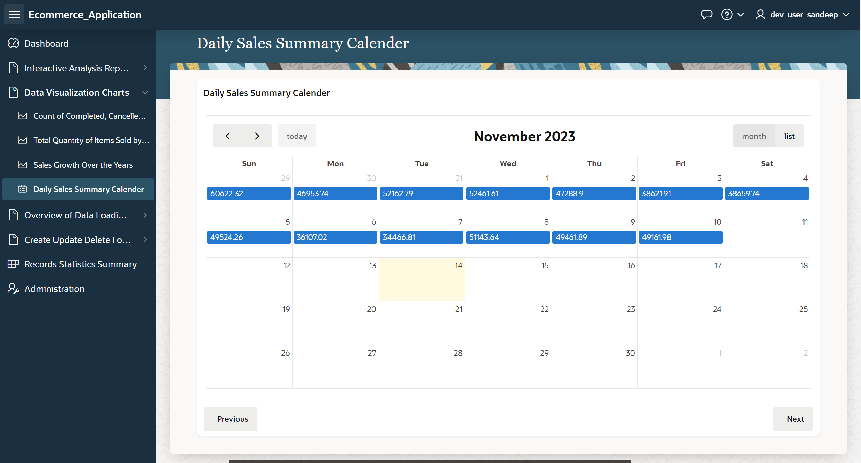
Daily Sales Summary Calendar: This page displays the total sales per day by all the stores.

Slide 22
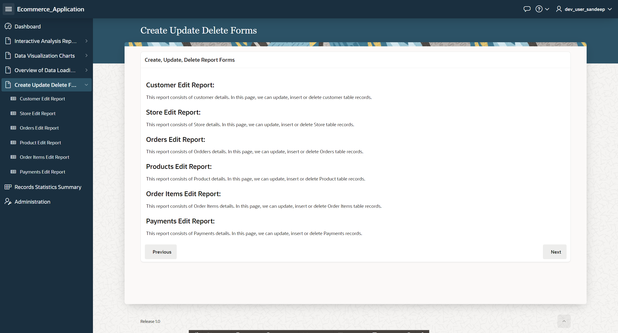
Create Update Delete Forms:

Slide 23
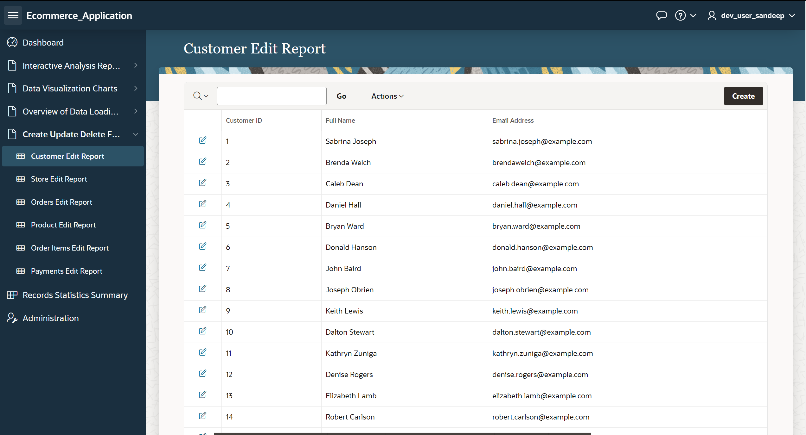
Customer Edit Report: User can edit the customer report like name and email address.

Slide 24
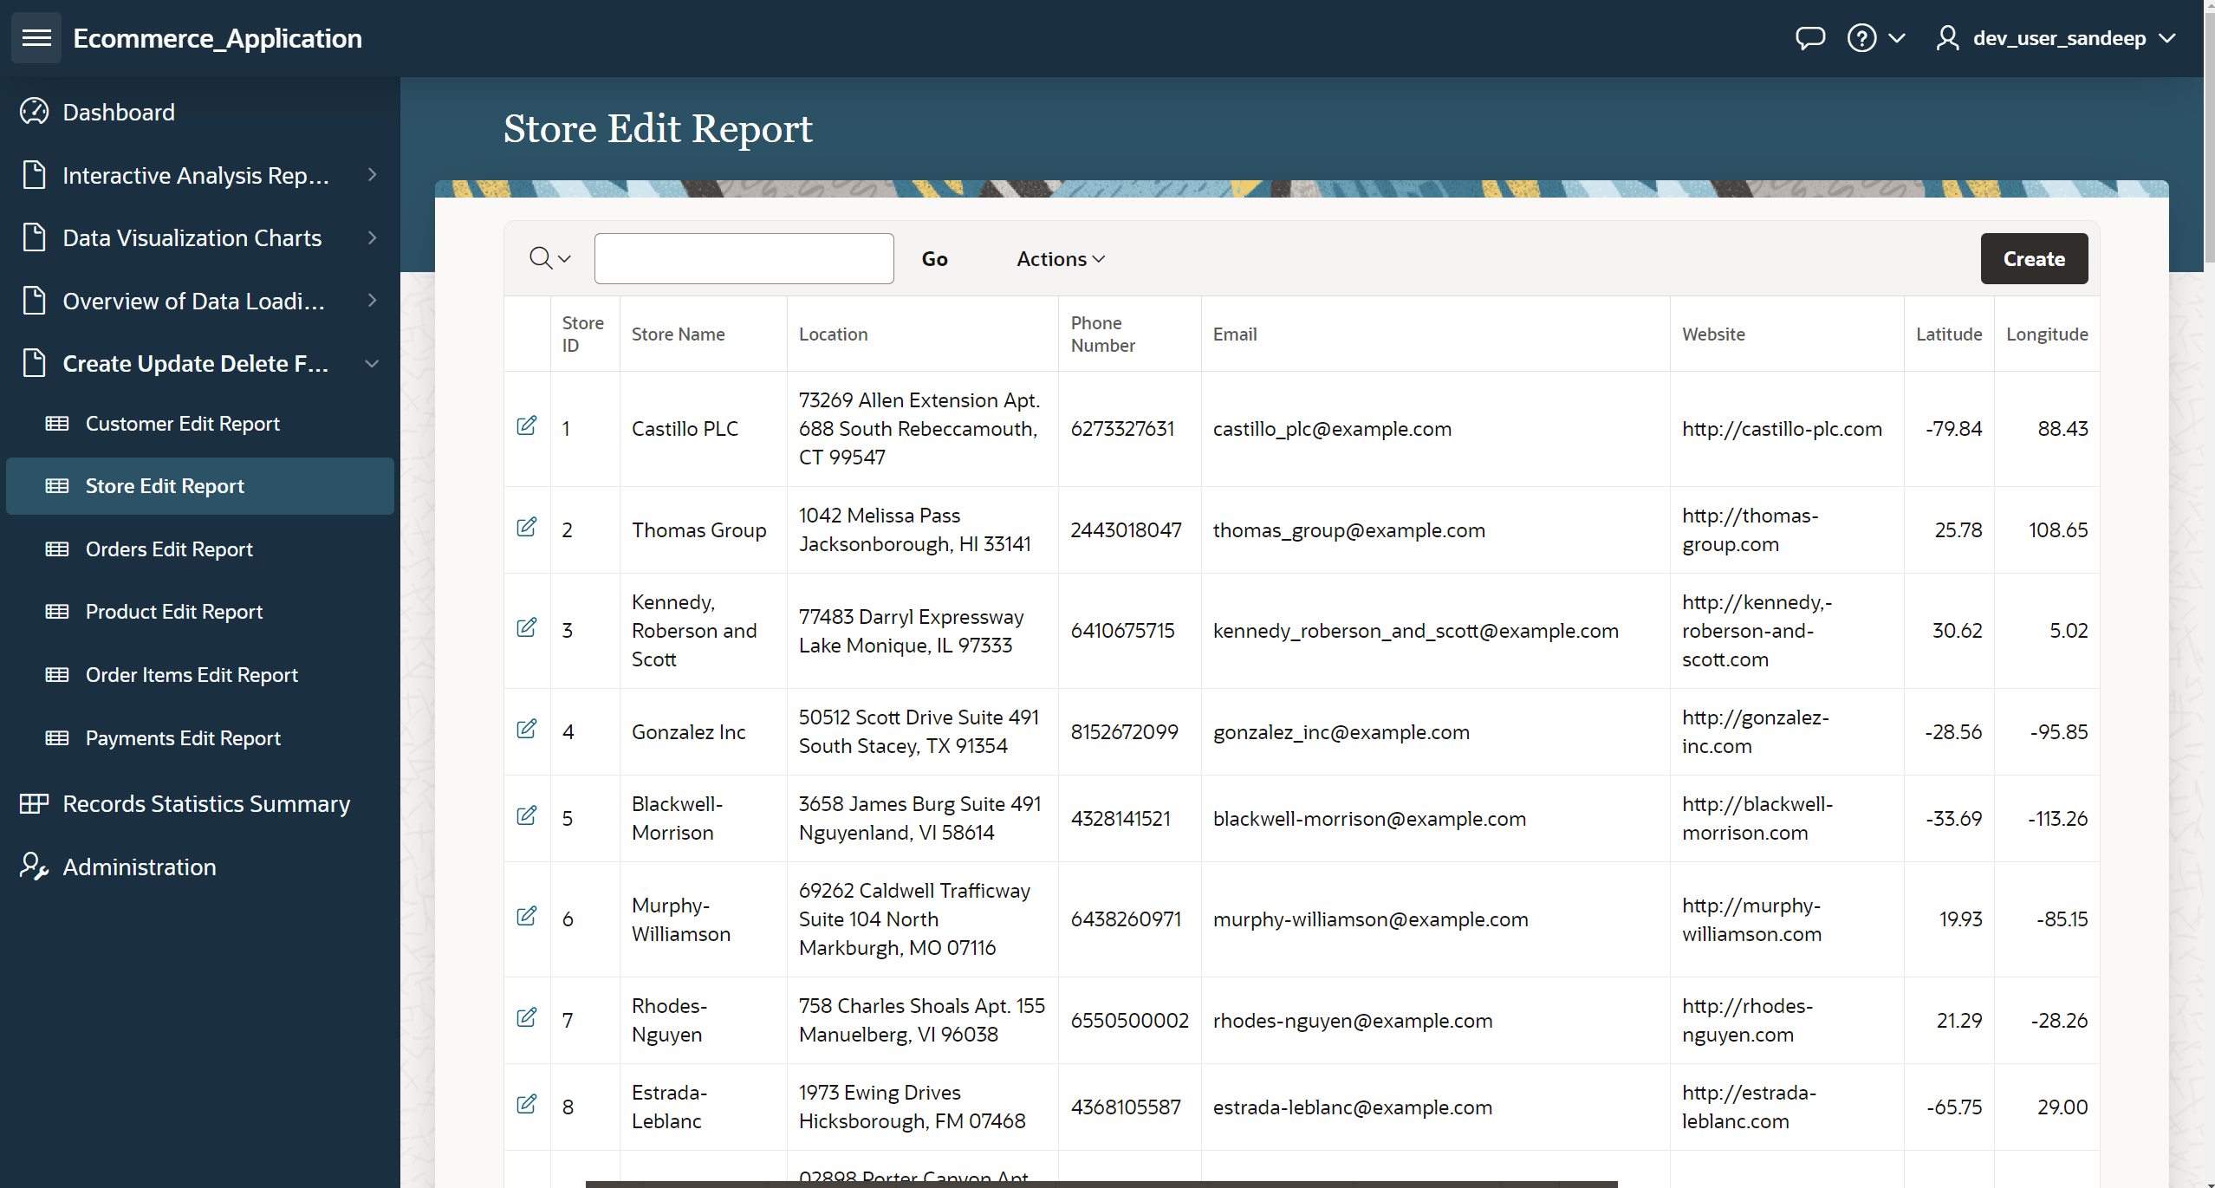
Store Edit Report: User can edit the store details like Store name, Location, phone number, email address, website.

Slide 25
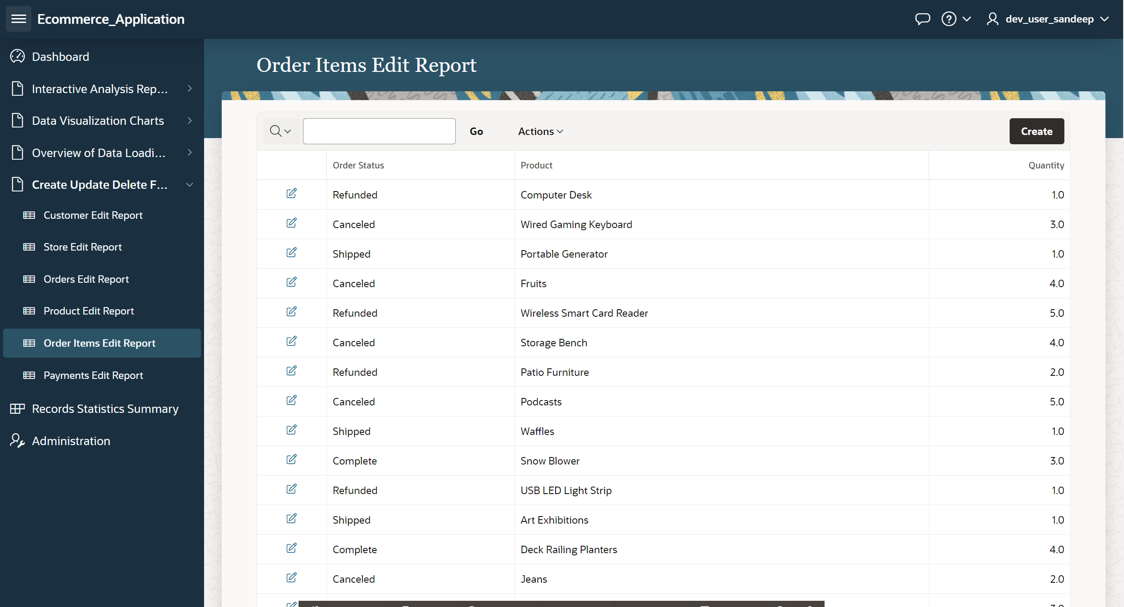
Order Items Edit Report: User can search for the order and edit the order.

Slide 26

Product Edit Report: User can search for the available Products and edit the details if needed.

Slide 27
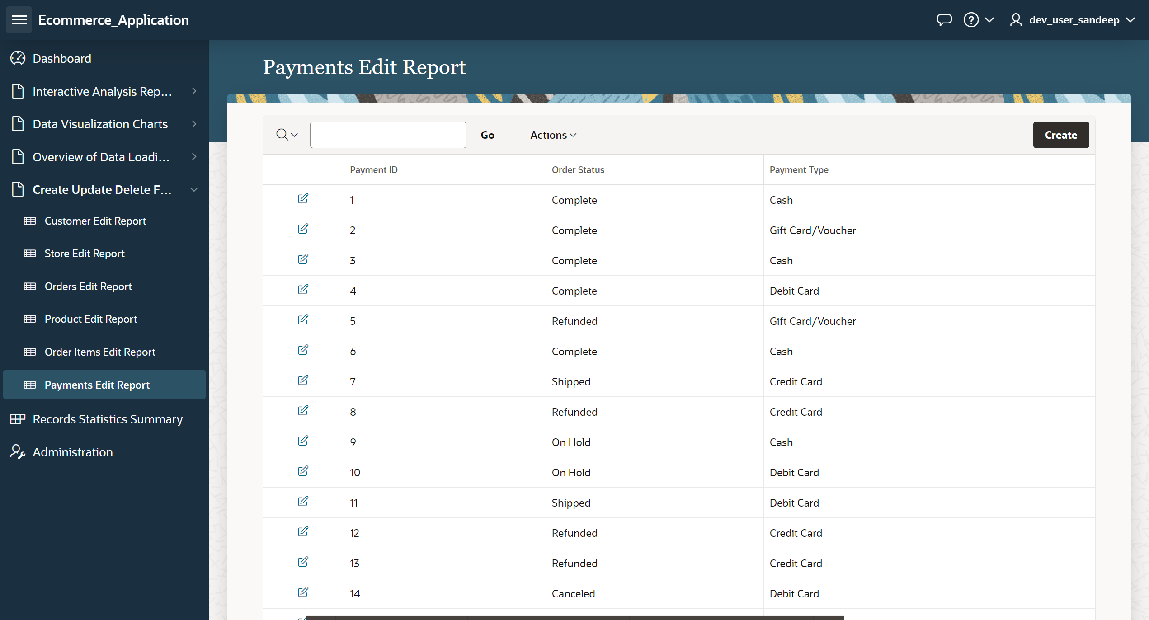
Payments Edit Report: User can search the payment details and edit them.

Slide 28
Conclusion
This project underscores the effectiveness of Oracle Application Express (APEX) in conjunction with Oracle Autonomous Database in creating a sophisticated e-commerce statistics application.
By harnessing the real-world Olist dataset, the project vividly demonstrates the practical application of these robust Oracle tools in managing and visualizing complex data.
Apex seamless execution of CRUD operations and the implementation of dynamic data visualization techniques illustrate the capabilities of Oracle APEX and the Oracle Autonomous Database to work in harmony.
The project not only achieves its initial objectives but also sets the stage for future enhancement, such as the integration of advanced analytics for deeper business insights. It stands as a prime example of leveraging modern technology solutions to build efficient, responsive, and data-driven applications in today's competitive e-commerce landscape.

Slide 29
Thank You !!!
Any Questions??

